Slide 1

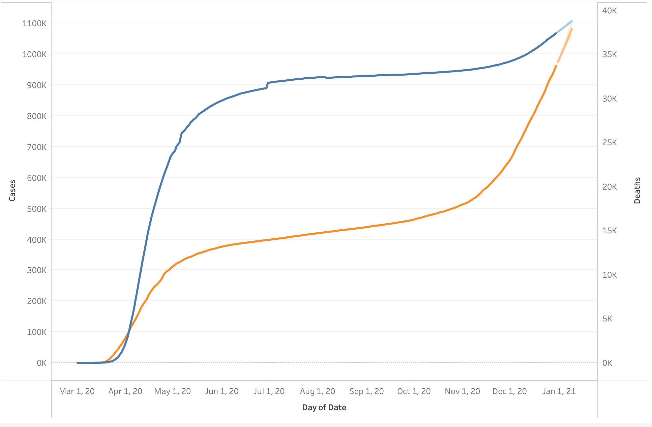
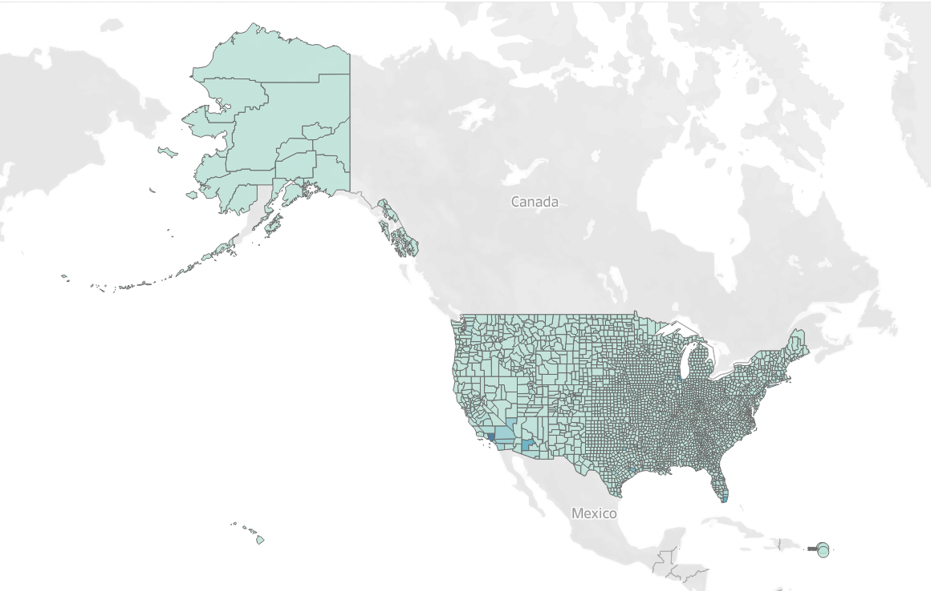
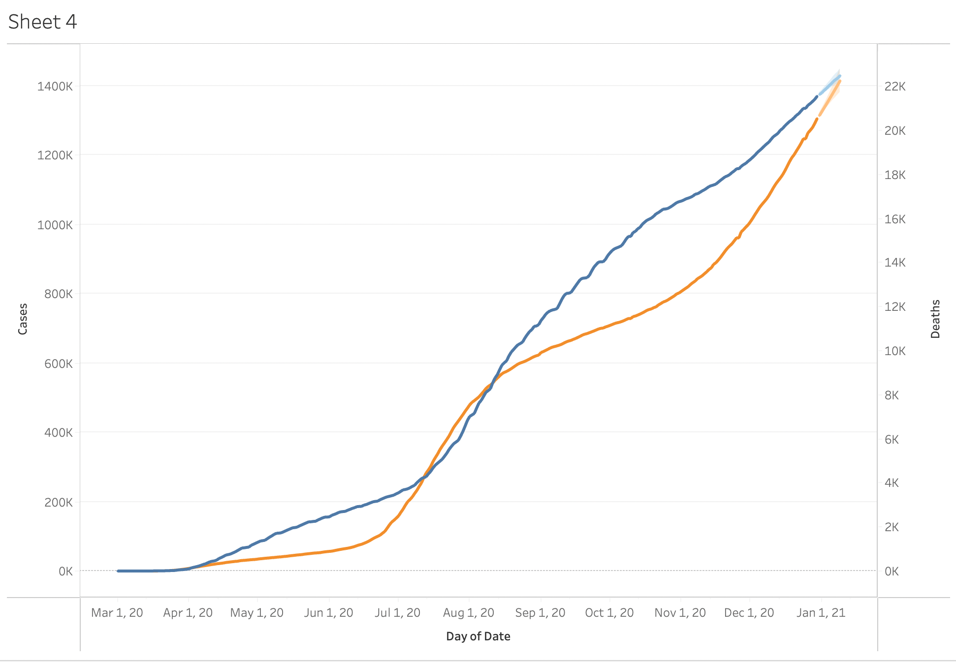
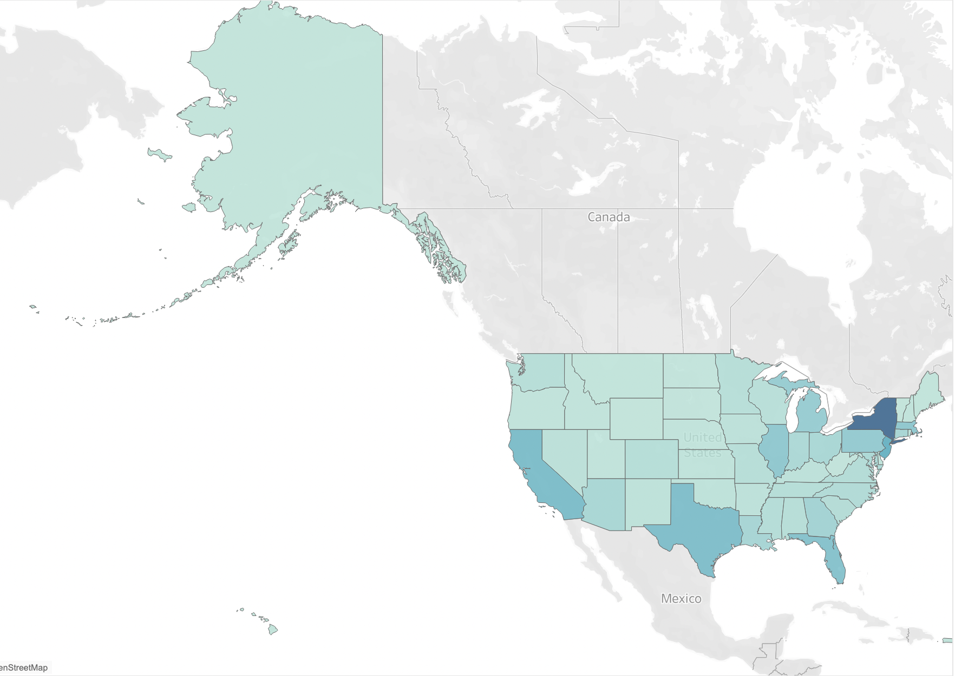
The Characteristics of Covid
Introduction
Data Visualization and Preparation
At the end of 2019, the sudden outbreak of coronavirus quickly spread rapidly to most countries around the world. The covid seriously threatens people's life and hinders the development of the economy.
There are lots of cases that have happened around us. We even caught the covid-19 and also felt the damage of covid to the economy. The inflationary effects of price rises and some relatives even went bankrupt. All those situations inspire us to do some analysis about the covid. We want to study and analyze the trends of covid data in the United States to reveal the influence among different locations and along the time. Besides, we also try to realize the relations between death count and other factors, so that we could go ahead one step before the damage happens. It's hard to defeat the enemy that we can't see and touch, but we'll be stronger standing on the truth and science.
pic1 : tendency of cases and deaths in the New York in 2020
pic2 : tendency of cases and deaths in the Florida in 2020
pic3 : the map that indicates how many deaths through all
the states in the United States in 2020.
pic4 : the map that indicates how many cases through all
the states in the United States in 2020.
Linear Regressopm Module
Methodology
Data : us-counties-2020
Attributes : date, county, stats, fips, cases, deaths
Tools : Jupyter Notebook, Tableau[2]
Module1 : Single Linear Regression Module
Input : cases
Predict : deaths
Module1 : Muptiple Linear Regression Module[3]
Input : cases, fips
Predict : deaths
There are three modules in this project:
Linear Regression Module
We use Linear Regression Module[1] and Multiple Linear Regression Module to calculate the relationships between cases, locations and deaths.
Support Vector Machine
Decision Tree Regression[7]

Slide 2
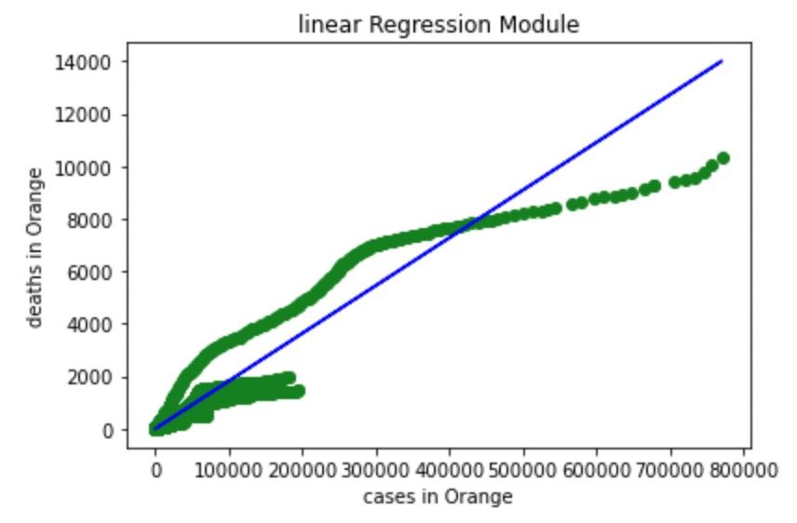
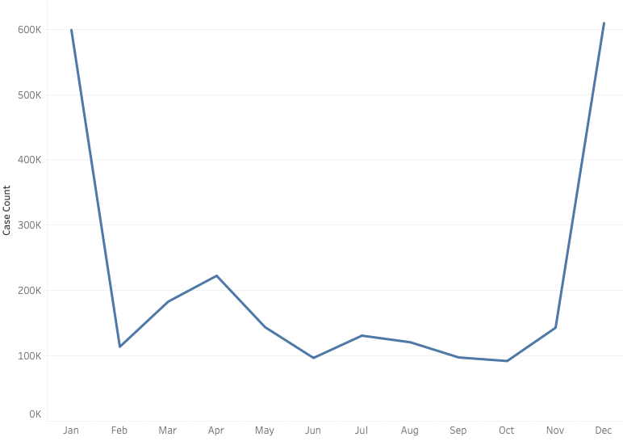
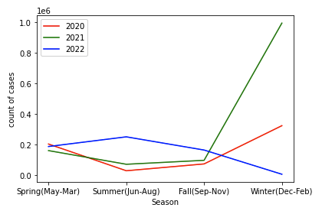
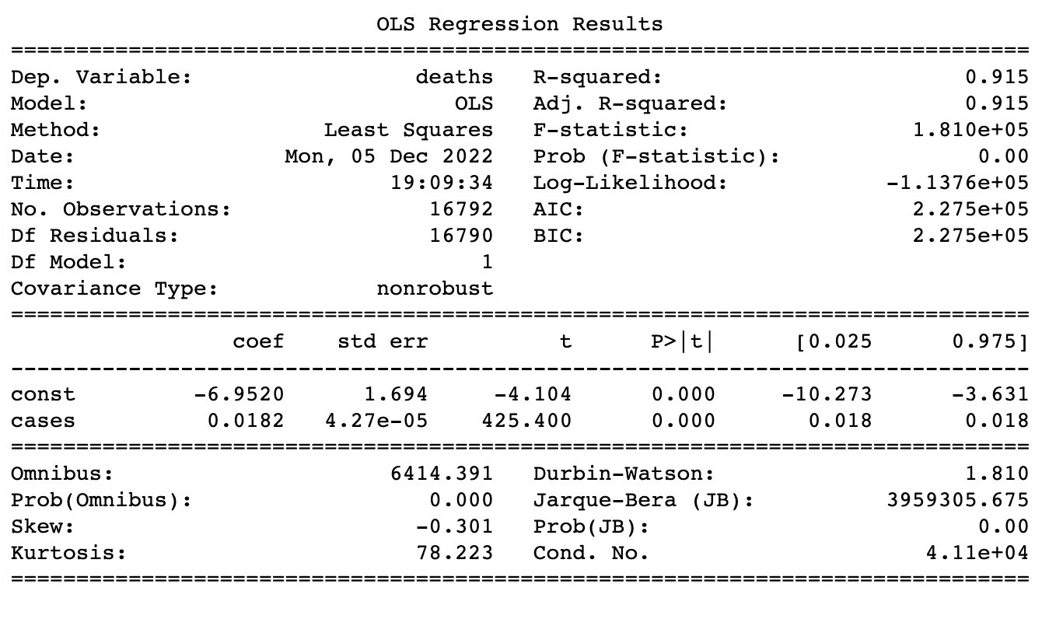
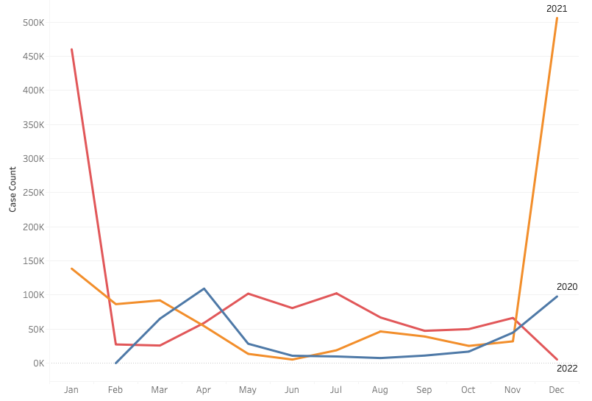
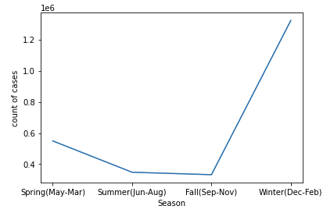
The Characteristics of Covid
Results
Data Visualization
pic1: total sum of cases in 2020-2022 per month
pic2: sum of cases per month for each year: 2020-2022
pic3: total sum of cases in 2020-2022 per season
pic4: sum of cases per season for each year: 2020-2022[4]
SVM Model
Data: NYC health Data[5]
Attribute used mainly: “Hospitalized_count”, “Deaths”
Tools : Jupyter Notebook, Tableau[2]
Model: SVM[6]
Input : “Hospitalized_count”
Predict : “Deaths”
Conclusion
Linear Regression Module:
The R-squared is 0.915, which is closer to 1. It means ’cases’ and ’deaths’ have strong relations. The p valus is 0, which is less than 0.05. It indicates ’cases’ are significant.

Slide 3
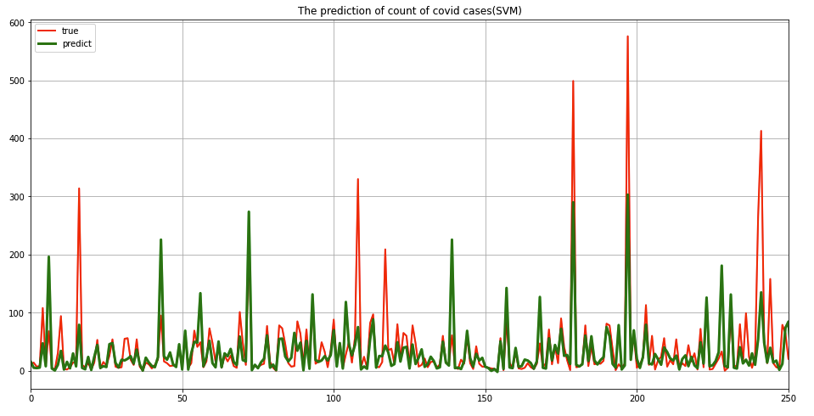
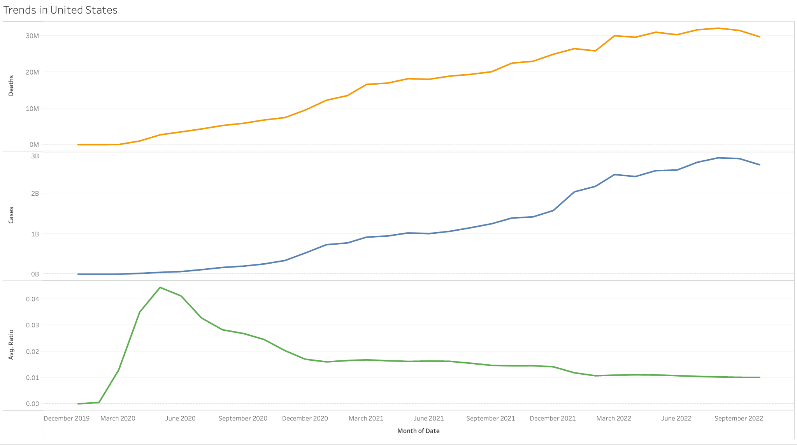
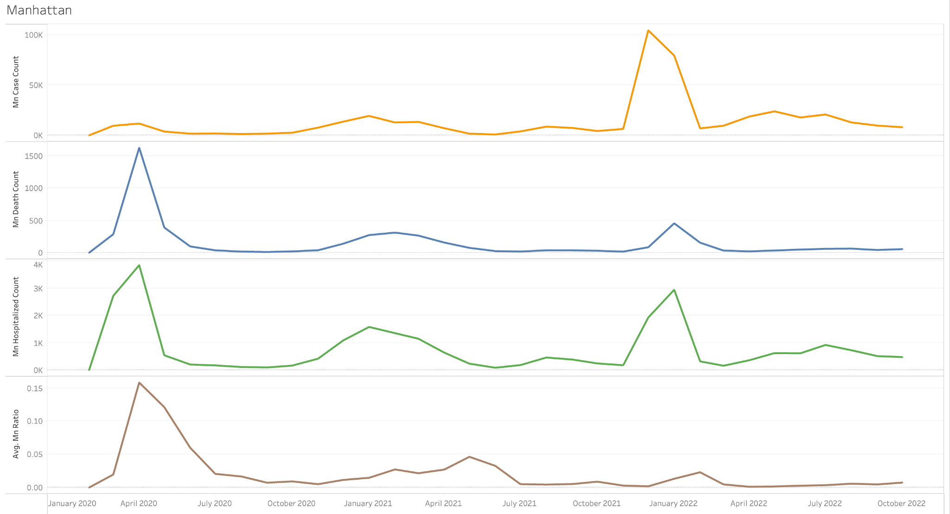
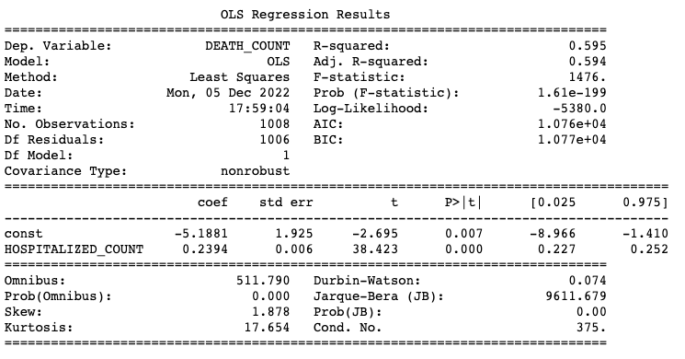
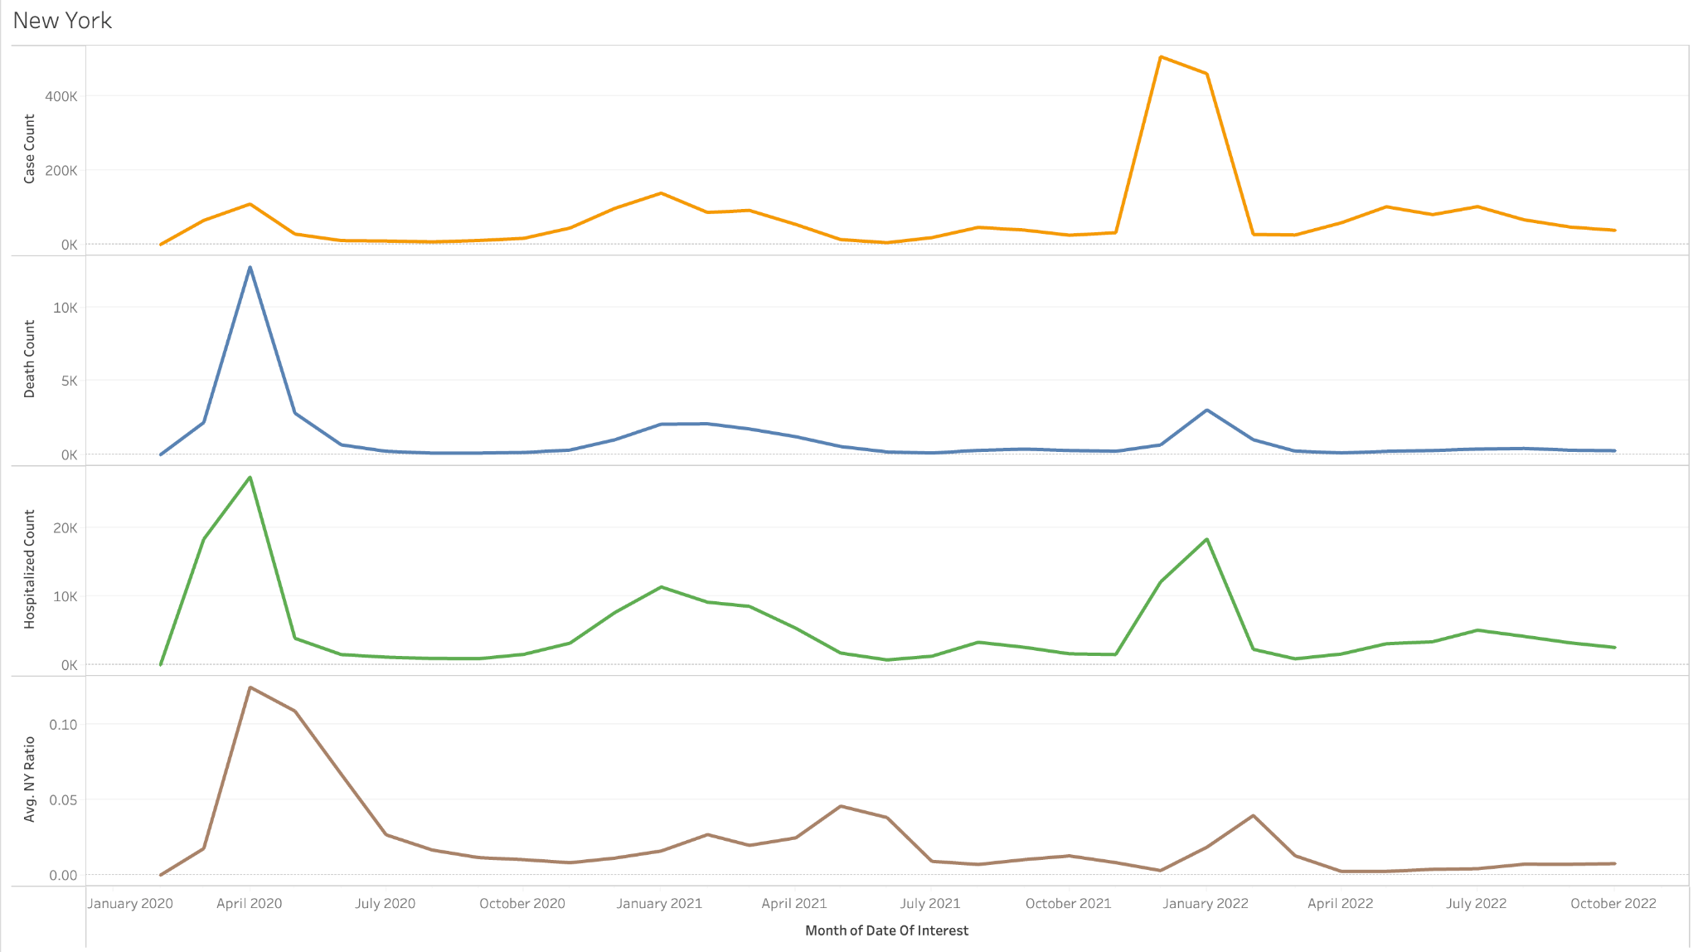
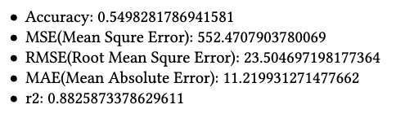
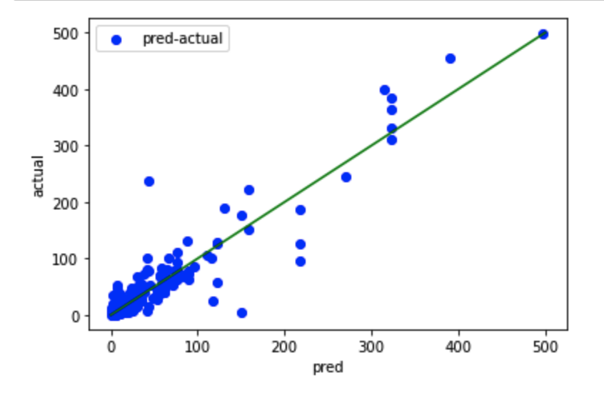
The Characteristics of Covid
Data Visualization
Real and predicted result on test data
accuracy: 52%
Trends in USA
Trends In Manhattan
Conclusion
Decision Tree Regression Model
The R-squared value is 0.595, which is relatively close to 1. That means there is a relatively strong relation between 'hospitalized count' and 'deaths'. Besides, the p-value is 0.007, which is small enough to show that 'hospitalized count' relates to 'deaths' strongly.
Trends In New York

Slide 4
The Characteristics of Covid
Discussion
Reference
Improve Linear Regression Module to Multicollinearity Module.
Add more attributes to the module by expanding the data.
Add time based prediction to predict the future death and hospitalized count.
[1] A. Nichols, “rd: Stata module for regression discontinuity estimation,” 2016.
[2] I. Ko and H. Chang, “Interactive visualization of healthcare data using tableau,” Healthcare informatics research, vol. 23, no. 4, pp. 349–354, 2017.
[3] S. Weisberg, Applied linear regression. John Wiley & Sons, 2005, vol. 528.
[4] W. S. Byun, S. W. Heo, G. Jo, J. W. Kim, S. Kim, S. Lee, H. E. Park, and J.-H. Baek, “Is coronavirus disease (covid-19) seasonal? a critical analysis of empirical and epidemiological studies at global and local scales,” Environmental Research, vol. 196, p. 110972, 2021.
[5] A. Tobías and T. Molina, “Is temperature reducing the transmission of covid-19?” Environmental research, vol. 186, p. 109553, 2020.
[6] J. Gu, M. Zhu, and L. Jiang, “Housing price forecasting based on genetic algorithm and support vector machine,” Expert Systems with Applications, vol. 38, no. 4, pp. 3383–3386, 2011.
[7] Decision Tree Regression. (n.d.). Scikit-learn. https://scikit-learn.org/stable/auto_examples/tree/plot_tree_regression.html

